Slide 1


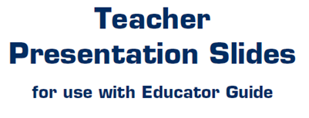


Slide 2
LEVEL 3, LESSON 2

Slide 3
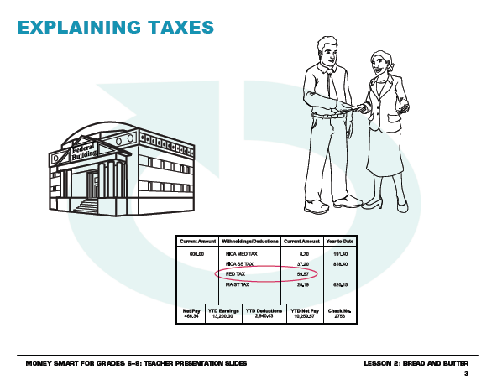

Slide 4
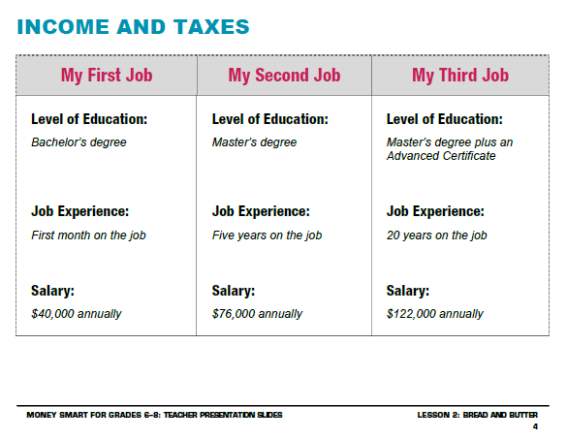

Slide 5
