Slide 1
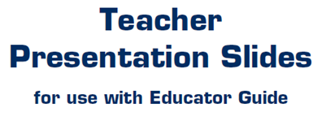

Slide 2
LEVEL 4, LESSON 12

Slide 5
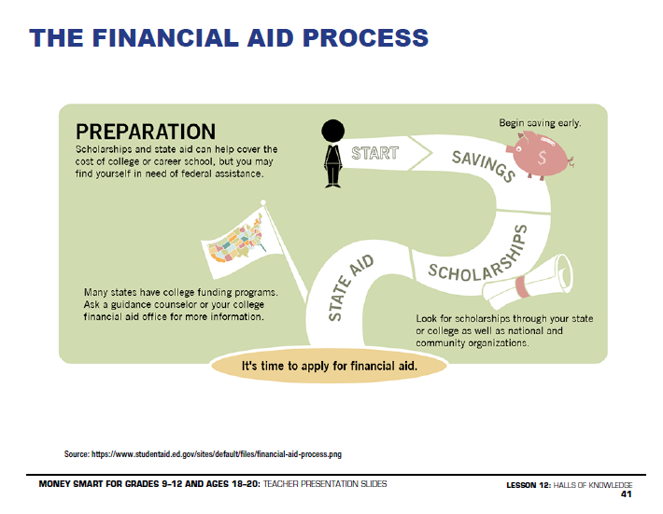

Slide 6
