Slide 1


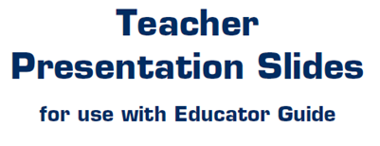


Slide 2

LEVEL 4 LESSON 13

Slide 3
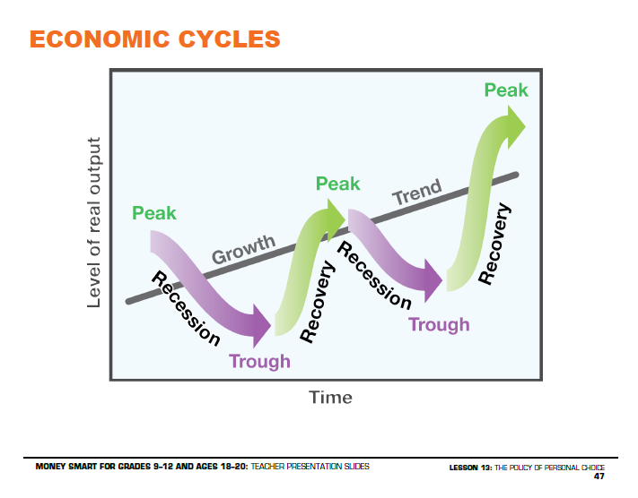

Slide 4
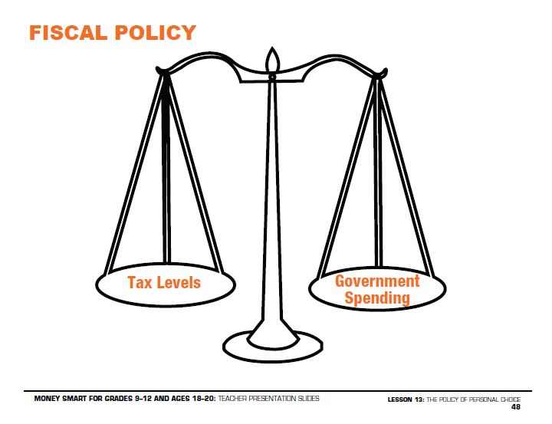

Slide 5
