Slide 1
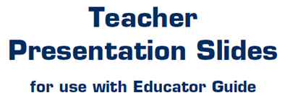

Slide 2
LEVEL 3, LESSON 2

Slide 4
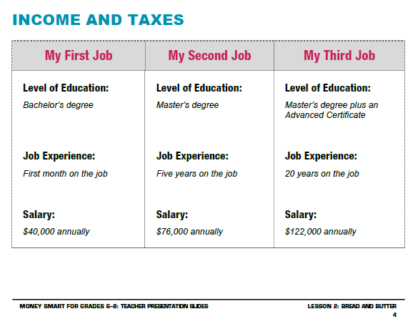

Slide 5
