Slide 1
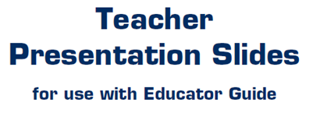

Slide 2
LEVEL 1, LESSON 2

Slide 3
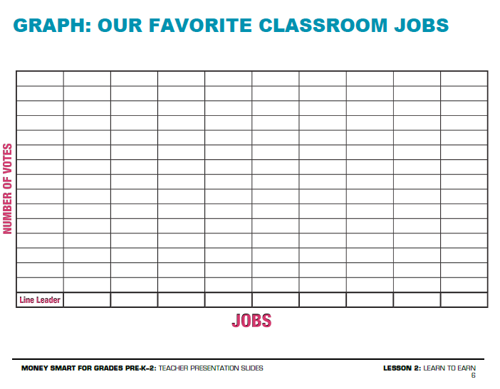

Slide 4
