Slide 1


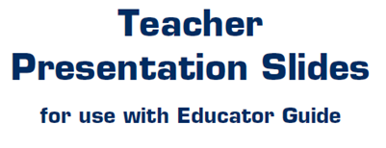


Slide 2

LEVEL 4, LESSON 6

Slide 4
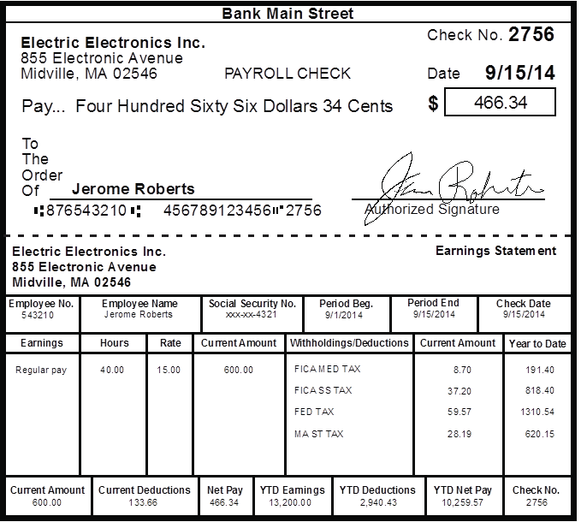
MONEY smart for grades 9-12 and ages and ages 18-20 Teacher Presentation slides lesson 6: bread-and-butter

